Slide 1

Telecom Churn Prediction
October 16th, 2024
Saunak Mitra
Sanjeev Kumar Singh
Sandeep Kumar

Slide 2

Agenda
1
Introduction
2
Problem Statement
3
Objectives
4
Dataset Overview
5
Pre-processing & EDA
6
Model Training & Evaluation
7
Results
8
Strategies
9
Conclusion
10
References

Slide 3

Introduction
Telecom churn refers to the phenomenon where customers stop using the services of a telecom companies.
High churn rates can lead to significant revenue loss, increased marketing costs, and a negative brand reputation
Retaining existing customers is more cost-effective than acquiring new ones, making churn prediction a key focus for telecom companies.
Predicting which customers are likely to churn allows companies to take proactive measures.
Effective churn prediction models help design targeted retention strategies

Slide 4

Problem Statement
Customer churn is a major challenge for retail loyalty programs,
leading to revenue loss and reduced customer engagement.
This project aims to develop a predictive model to identify
customers at risk of leaving, allowing for targeted retention
efforts to improve customer loyalty and reduce churn rates.

Slide 5

Objectives
Understanding Churn Drivers
Identifying At-Risk Customers
Improving Decision-Making

Slide 6
Dataset Overview
Source: The dataset contains information from a telecom company providing home phone and internet services to 7,043 customers in California during Q3.
Demographics
Age
Billing & Payment
Monthly Charges
Churn
Yes
Service Details
Gender
Senior Citizen
Marital Status
Total Charges
Contract Type
Payment Method
No
Key Features
Phone Service
Internet Service
Online Security
Device Protection
Streaming TV/Movies.

Slide 7

Data Pre-processing
Handled missing values through imputation.
Encoded categorical variables
Applied scaling techniques (Min-Max Scaling or Standardization) to numerical features.
Used SMOTE to generate synthetic samples for the minority class (churned customers).
Removed irrelevant features to enhance model efficiency.

Slide 8
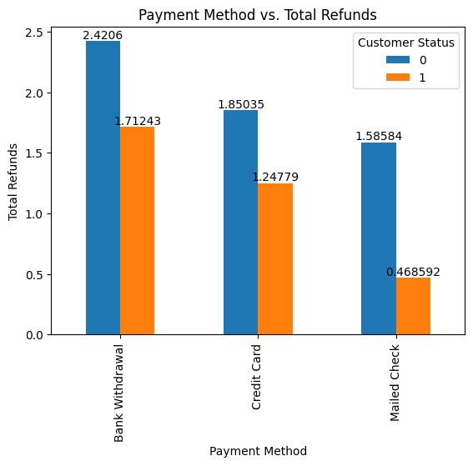
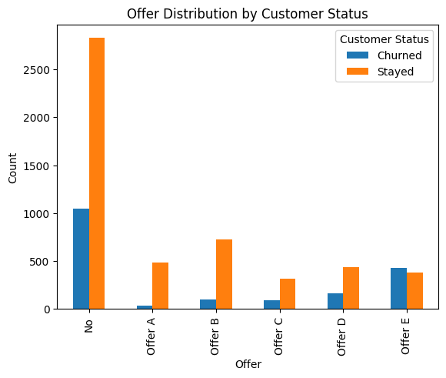
Exploratory Data Analysis

Slide 9
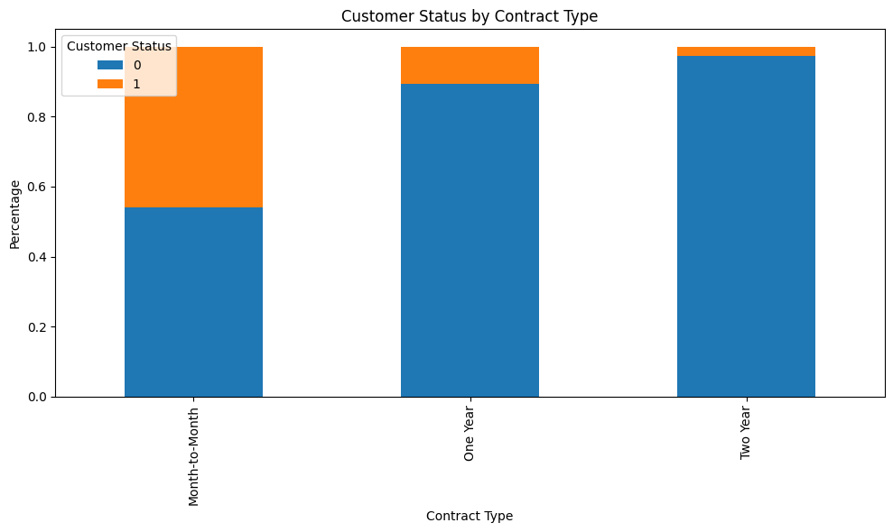
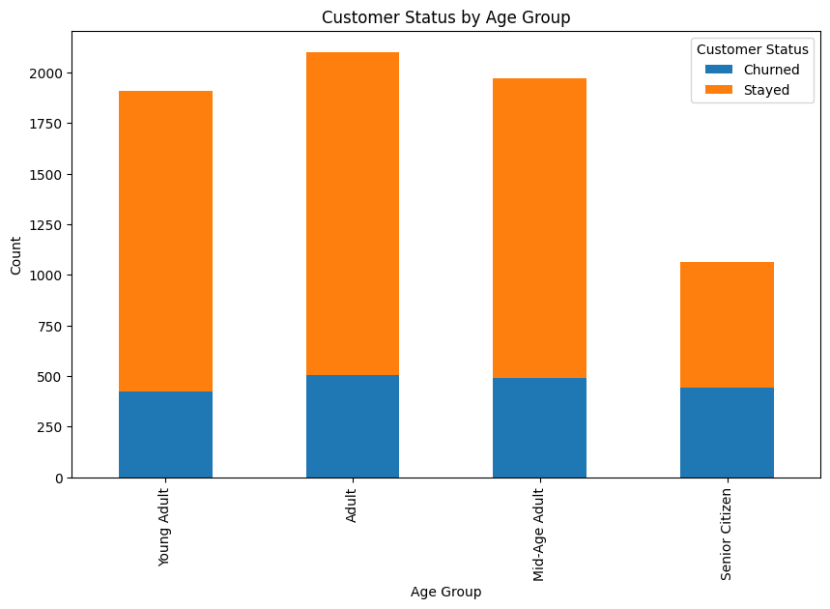
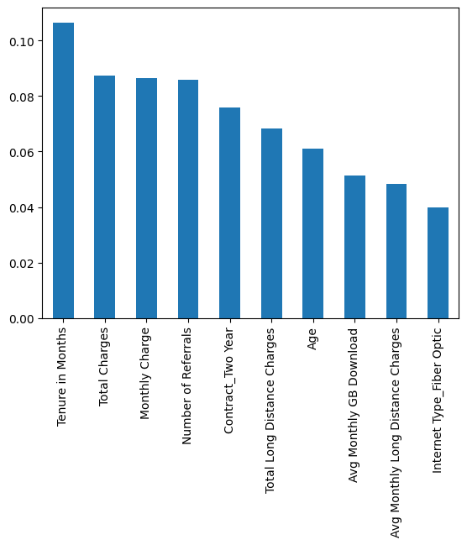

Slide 10
Model Training & Evaluation
Model Training:
Evaluation Metrics:
Logistic Regression
Random Forest
Precision and Recall: Especially useful for imbalanced data like churn prediction.
F1-Score: Harmonic mean of precision and recall, providing a balance between the two.
Confusion Matrix: Helps understand where the model made correct and incorrect predictions.
Trained models using the 80% training dataset.
Used Stratified sampling to divide dataset into homogeneous groups.
Applied SMOTE to address class imbalance
Implemented cross-validation to ensure model robustness and prevent overfitting.
KNN
XGBoost

Slide 11
Results
Implemented multiple models: Random Forest, Logistic Regression, XGBoost, KNN and LGBM Classifier.
LGBM Classifier achieved the highest F1 Score of 0.7 among all models.
The cross-validation results confirmed the robustness of the LGBM Classifier.

Slide 12

Strategies
Segment-Based Targeting
Contract Incentives
Early Engagement
Customer Support and Communication
Personalized Offers
Competitive Pricing

Slide 13




Conclusion
Back
Home
Effective Churn Prediction: Key factors like contract type, monthly charges, and tenure identified as drivers of churn.
Actionable Insights: Provided strategies for customer retention based on data analysis.
Loyalty Program Optimization: Recommendations for personalized offers and contract incentives to reduce churn.
Business Impact: Enable Proactive measure to enhance customer loyalty and reduce turnover.

Slide 14
References
Kline, R.B. (2011). Principles and practice of structural equation modeling (5th ed., pp. 3-427). New York:The Guilford Press.
Edwards, A. (1976). An introduction to linear regression and correlation. W. H. Freeman.
Everitt, B. S.; Skrondal, A. (2010), The Cambridge Dictionary of Statistics, Cambridge University Press.
Applied Predictive Modeling (by Kuhn & Johnson).
Hands-On Machine Learning with Scikit-Learn, Keras, and TensorFlow (by Aurélien Géron).
Master Machine Learning Algorithms (by Brownlee).
Python Feature Engineering Cookbook (by Galli) .
Imbalanced Classification with Python(by Brownlee).

Slide 15

Thank you

Slide 16
Objectives
Back
Home
This project addresses the challenge of customer retention faced by telecom companies. Specifically, the problem is:
Understanding Churn Drivers: Without a clear understanding of why customers are leaving, companies struggle to implement effective retention strategies.
Identifying At-Risk Customers: Creating a Customer Churn Prediction model for anticipate customer attrition, enhance loyalty program effectiveness, and improve customer retention in retails.
Improving Decision-Making: The project aims to help telecom companies make data-driven decisions to better allocate resources, offer targeted incentives, and improve customer satisfaction to reduce churn.

Slide 17

Strategies
Segment-Based Targeting :
Focus on younger customers who are less likely to churn and offer tailored incentives to older customers at higher churn risk.
Contract Incentives :
Encourage longer-term contracts by offering discounts or additional benefits to month-to-month customers, reducing churn from short-term commitments.
Early Engagement :
Implement targeted engagement for new and short-tenure customers to improve their experience early on, reducing early-stage churn.
Personalized Offers :
Offer persolized discounts or loyalty reward to high-paying customers to enhance value and reduce churn risk.
Customer Support and Communication :
Proactively engage customers with low usage or complaints by offeringpromotions and resolving issues to prevent churn.

Slide 18
Visual Encoding and Design Principles
Visual encoding plays a crucial role in transforming data into visual elements for easy comprehension and communication.
Different visual variables like position, length, angle, color, and size influence how viewers perceive and interpret data.
Applying design principles such as simplification, hierarchy, consistency, and alignment enhances visual clarity and aesthetics.
Careful selection and combination of visual variables and design principles lead to more effective and impactful data visualizations.
Striking the right balance between information clarity and aesthetics improves audience engagement and understanding of the data.

Slide 19
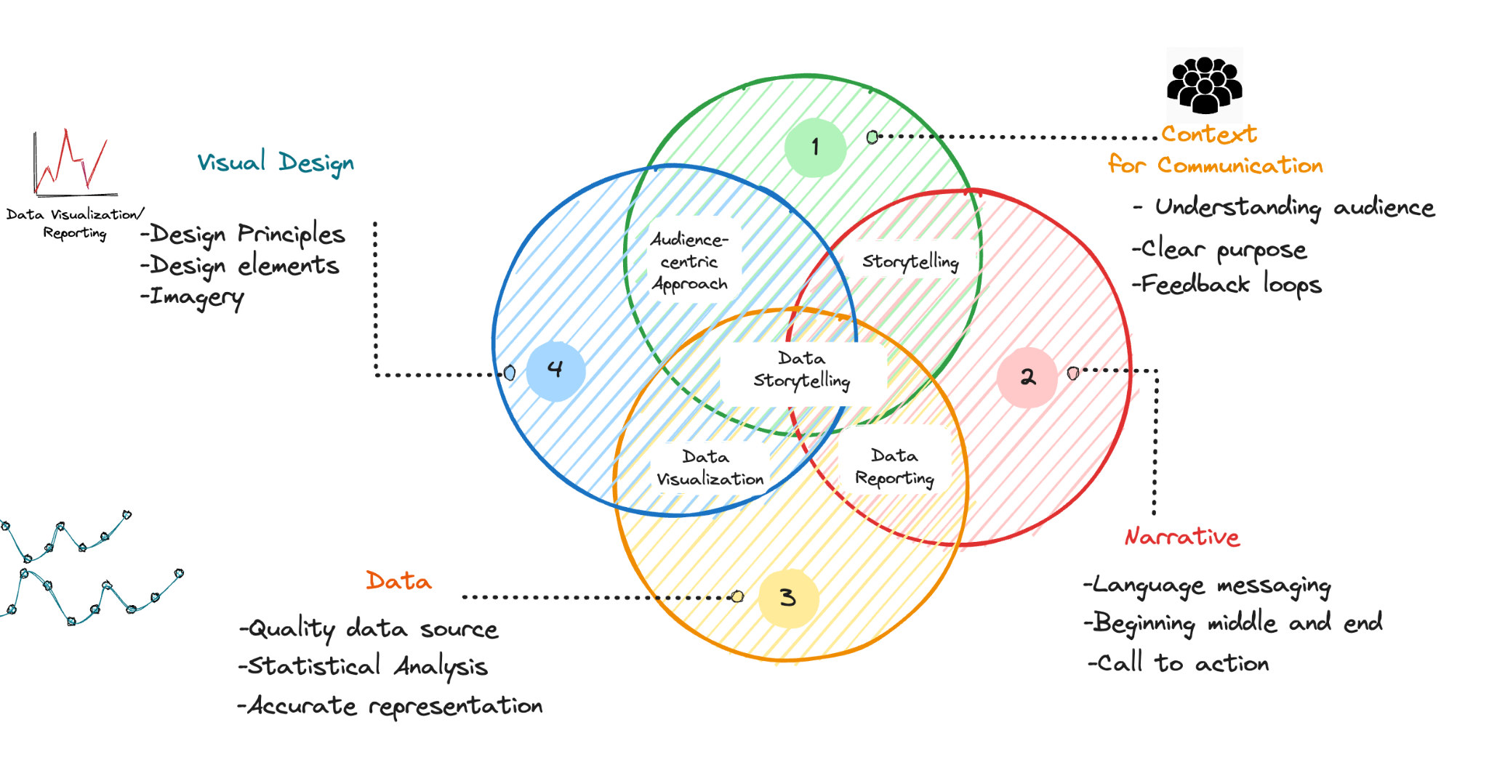
Storytelling with Data with Data

Slide 20

Storytelling with Data
Storytelling with data visualization involves crafting a compelling narrative that guides the audience through the insights and conclusions derived from the data.
Building a narrative structure ensures a logical flow in presenting the data, from introducing the problem to providing key insights and conclusions.
Annotations and context, such as labels, captions, and additional information, help provide deeper understanding and context to the visualizations.
Thoughtful use of data visualization elements, such as titles, subtitles, and annotations, can emphasize important points and enhance the impact of the story.
By combining data visualization with a well-structured narrative and context, you can create engaging and persuasive stories that effectively communicate data-driven insights.

Slide 21

Interactive Data Visualization
Interactive visualizations offer dynamic exploration and analysis of data, enabling users to gain deeper insights and discover patterns through active engagement.
Various techniques, such as interactive filters, zooming, and tooltips, empower users to focus on specific data subsets and obtain real-time information on demand.
Effective interactive data visualizations can include interactive maps with drill-down features, interactive dashboards, and dynamic charts that allow users to interactively explore data patterns.
Interactivity fosters user engagement and facilitates better data-driven decision-making, as users can manipulate the visualizations to answer specific questions and gain a comprehensive understanding of the data.
By providing meaningful and intuitive interactions, interactive data visualizations empower users to uncover hidden insights, leading to more informed decisions and actionable outcomes.

Slide 22

Common Pitfalls and Best Practices
Common pitfalls in data visualization include using 3D charts unnecessarily, distorting scales, and overusing colors, leading to misleading or confusing representations.
Data overload can be addressed by focusing on key insights and simplifying the visualization to highlight the most relevant information for the audience.
Best practices for improving accessibility and inclusivity involve providing alternative text descriptions for visual elements, using color combinations with sufficient contrast, and considering various color-blind friendly palettes.
Maintaining clear labels, concise titles, and appropriate data units helps avoid confusion and ensures that the audience can interpret the visualizations accurately.
Regularly seeking feedback from the audience and iterating based on user testing helps in creating more effective and impactful data visualizations.

Slide 23

Tools and Resources
Back
Home
Popular data visualization tools like Tableau, Power BI, and ggplot offer intuitive interfaces and robust functionalities for creating diverse visualizations.
Online resources such as data visualization tutorials, blogs, and video courses can help learners deepen their understanding of visualization techniques and best practices.
Engaging with data visualization communities, such as forums and social media groups, provides opportunities to share knowledge, seek advice, and stay updated on the latest trends in the field.
Many online platforms offer interactive data visualization challenges and competitions, enabling individuals to practice and showcase their skills in real-world scenarios.
Leveraging open-source libraries like Matplotlib and D3.js can offer more flexibility and customization options in data visualization projects, especially for advanced users and developers.

Slide 24

Key Takeaways
Data visualization plays a crucial role in decision-making processes by presenting complex information in a visually compelling and easily understandable format.
Understanding data types, including qualitative and quantitative data, helps in selecting appropriate visualization techniques that effectively represent the information.
Choosing the right chart types based on data and goals ensures clear and accurate communication of insights while avoiding misleading visualizations.
Visual encoding and design principles, such as utilizing visual variables and maintaining consistency, enhance the effectiveness and aesthetics of data representations.
Storytelling with data allows for the creation of compelling narratives that engage stakeholders and communicate key messages effectively, while interactive visualizations facilitate deeper exploration and analysis of the data.

